Slide 1


the Course
Customer value
Types of Benefits
Differentiation
Positioning
Session 6
Customer Value
Session 7
Go to Market 1
Elements of GTM
Anchor vs user TG
Parameters of Marketing & Go to Market
Session 8
Go to market 2
Channel & Retail Environment
Platforms
Session 9
Drive Growth & Measuring Success
PITA
Marketing Objectives
Brand Health
Growth, Marketing Objectives & How to measure them
Session 10
Measuring Success
Business health
Digital Funnel & Measurements

Slide 2
Customer/Consumer Value
The difference between
the benefits a customer sees from a market offering and the costs of obtaining those benefits
Value = Benefits - Costs
The benefits can be
Operational
Performance
Intimacy
Useful links - https://www.zendesk.com/blog/customer-value/?
https://hbr.org/1998/11/business-marketing-understand-what-customers-value?
Notes:
Useful links - https://www.zendesk.com/blog/customer-value/?
https://hbr.org/1998/11/business-marketing-understand-what-customers-value?

Slide 3



Benefits on 3 Parameters
Operational Excellence
Performance Superiority
Consumer Intimacy

Slide 4


Differentiation
Differentiation can be based on -
Operational Benefits
Performance Benefits
Consumer/Customer Intimacy
Delivery, service, reliability, cost
Product attributes, style, design, innovation, ingredients, etc.
Does it meet the consumer needs, e.g. – protection, entertainment, recognition, etc.
Notes:
At a meta level, there are 3 parameters of differentiation

Slide 5
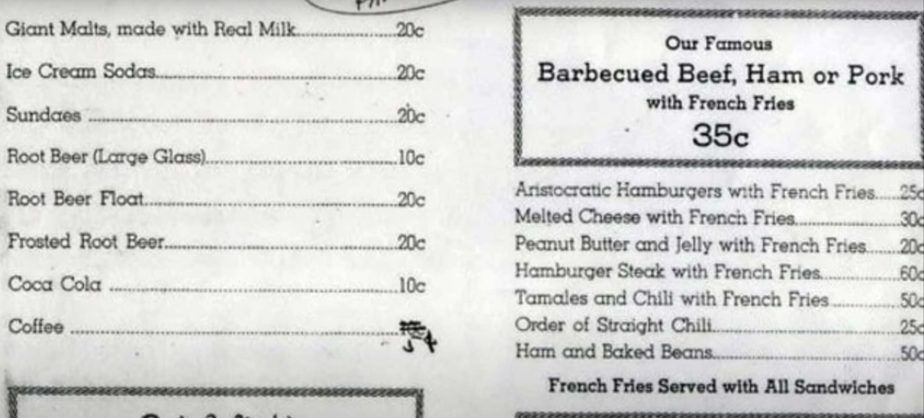
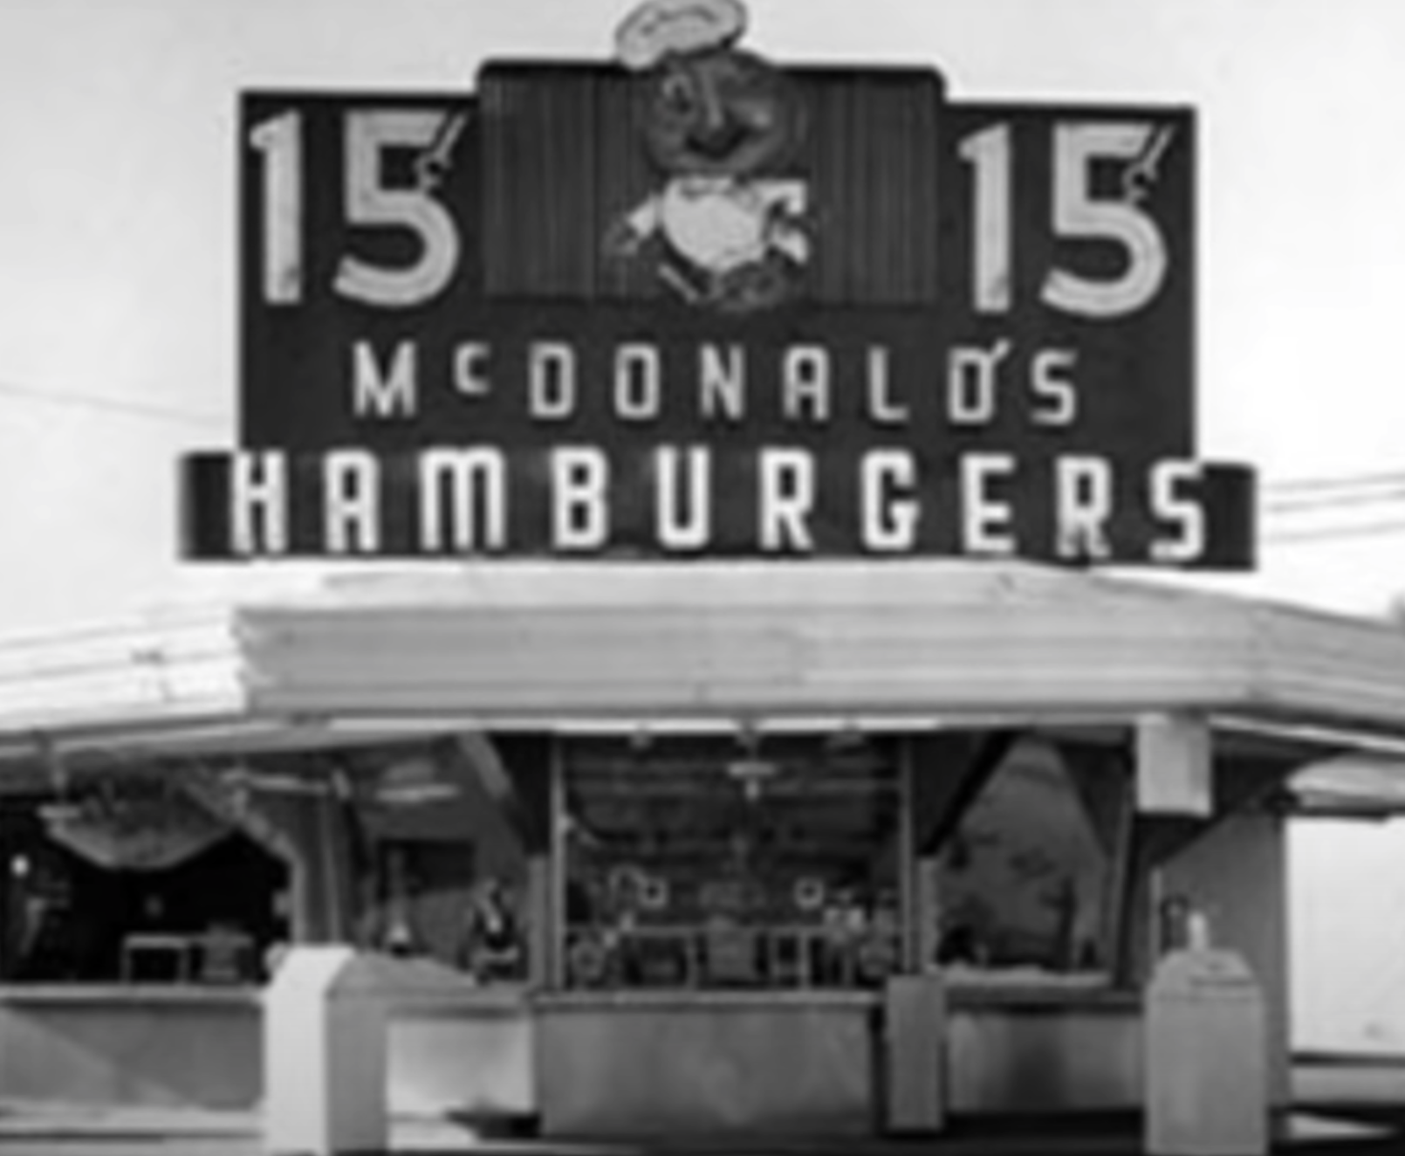

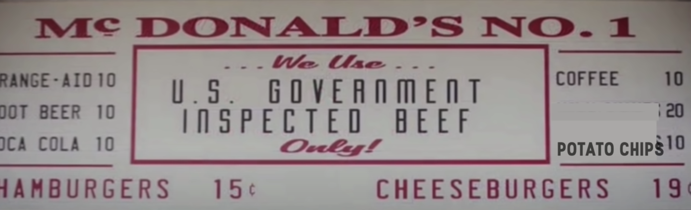
Examples of Differentiation - McDonalds
Notes:
Useful Watch – The Movie – “The Founder”
Useful Links -
https://www.youtube.com/watch?v=9tOsm2_JAT4

Slide 6
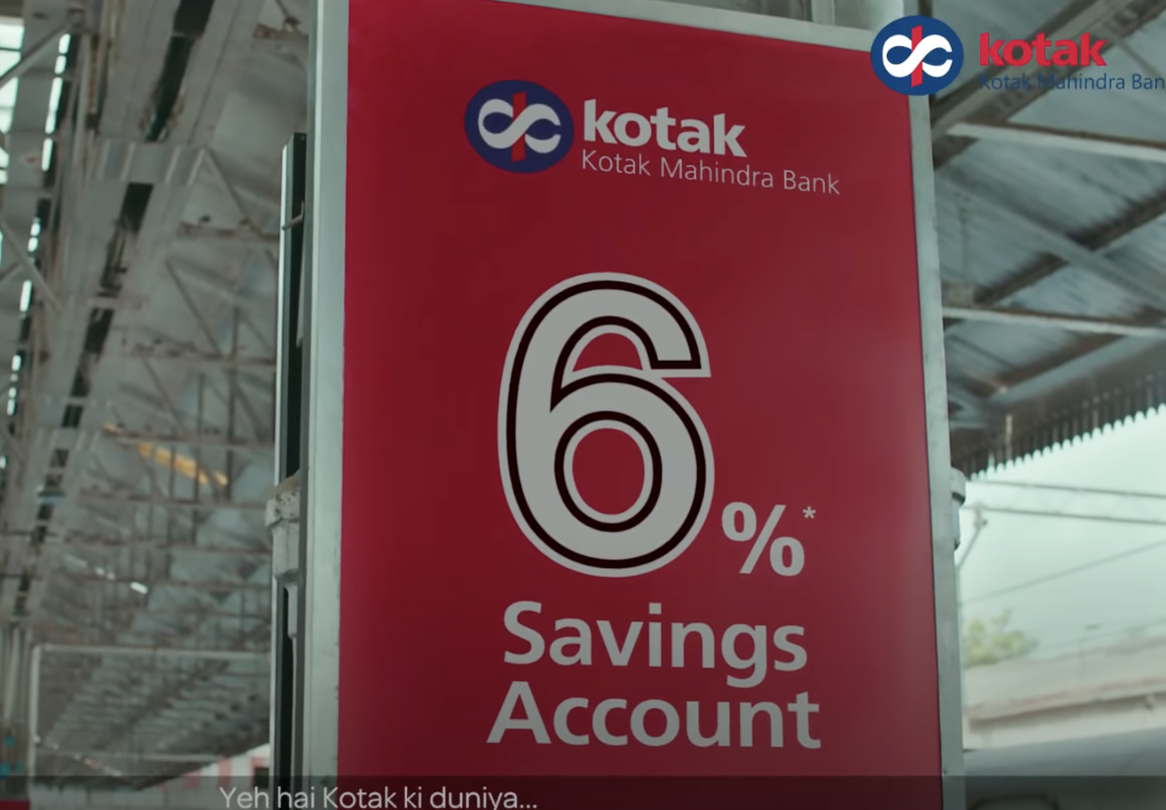

Examples of Differentiation - Banking Services

Slide 7

Examples of Differentiation – Reducing Friction
Notes:
Useful Links
https://bretwaters.medium.com/case-study-dollar-shave-club-a9503fc83ea0

Slide 8
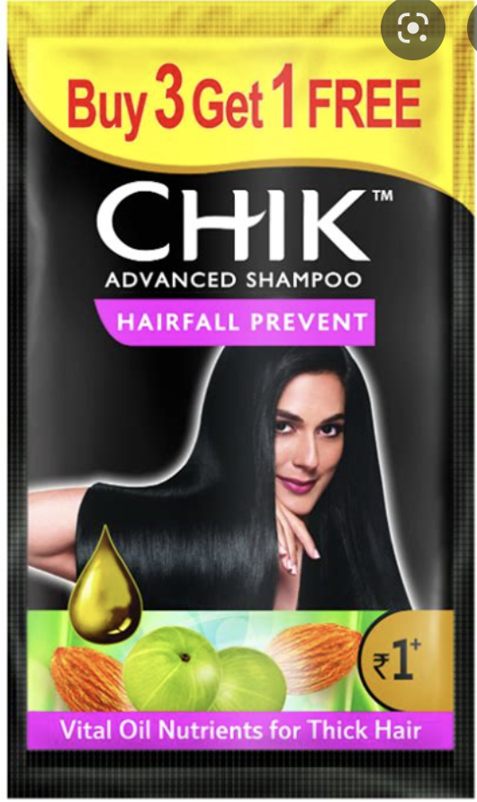

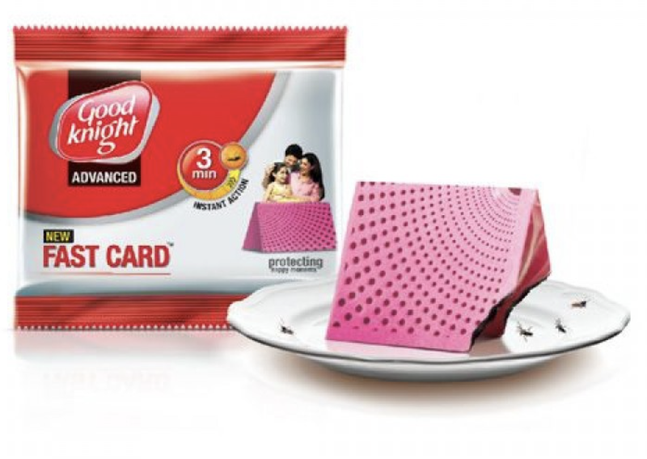
Examples of Differentiation - Form
Notes:
Useful Links - https://marketingmind.in/all-you-need-to-know-about-the-sachet-revolution-in-india-in-early-80s/

Slide 9

Examples of Differentiation - Tesla

Slide 10
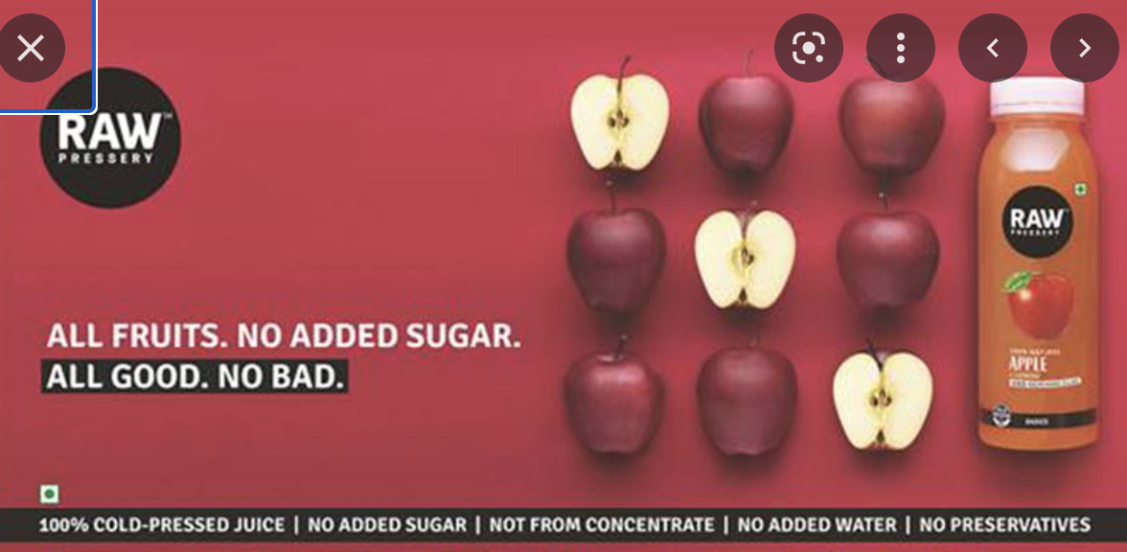
Examples of Differentiation - RAW

Slide 11

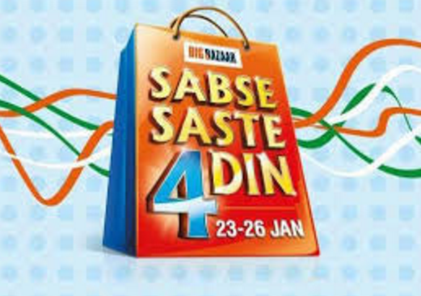
Examples of Differentiation - Big Bazaar

Slide 12

Some examples of differentiation - HDFC standard life
Notes:
https://www.youtube.com/watch?v=ui9GPNYpvVc

Slide 13

Some examples of differentiation - Nicoderm
Notes:
https://beloved-brands.com/consumer-insight/

Slide 14

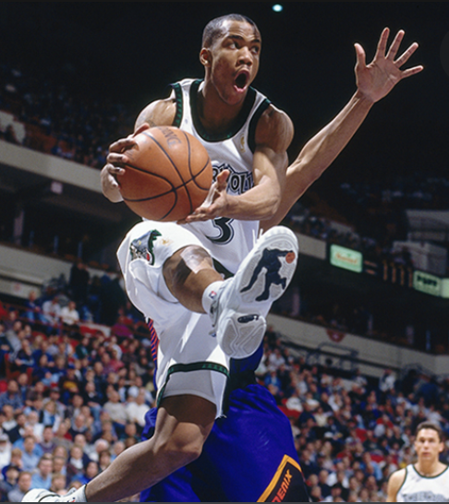

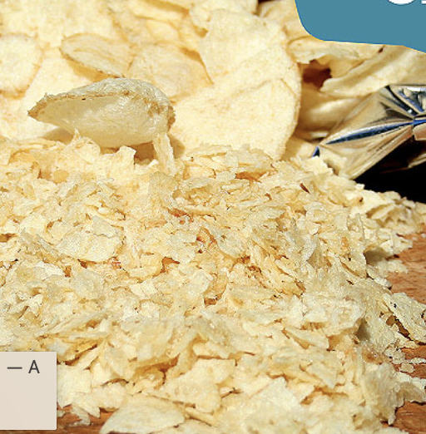
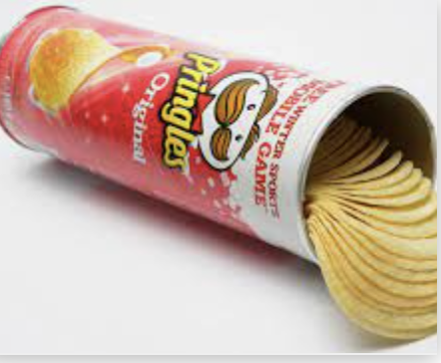
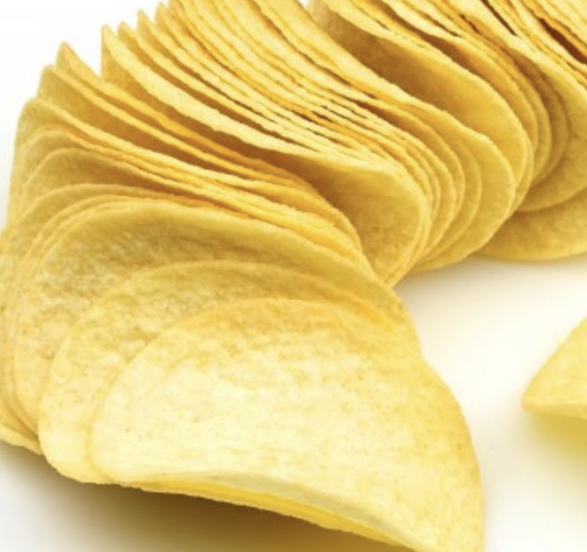


How to Identify?
OBSERVATION
AND 1 found counter- culture in street ball
PROBING CONSUMERS USAGE ISSUE
Pringles Unique Shape and packaging
DREAM PRODUCTS
We work model of connected community
Notes:
Useful Watch – Netflix Untold – Rise and fall of AND 1
Useful Watch – WeCrashed Web series

Slide 15

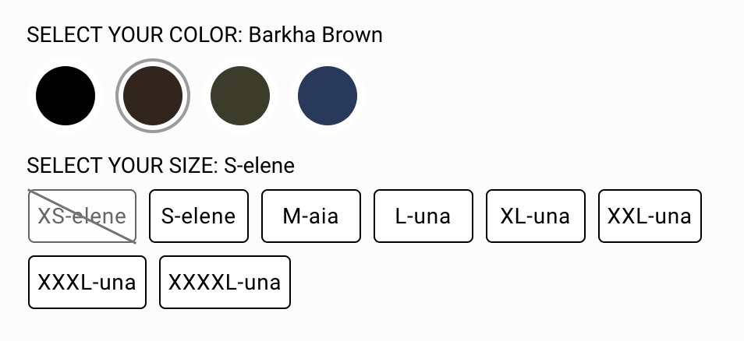
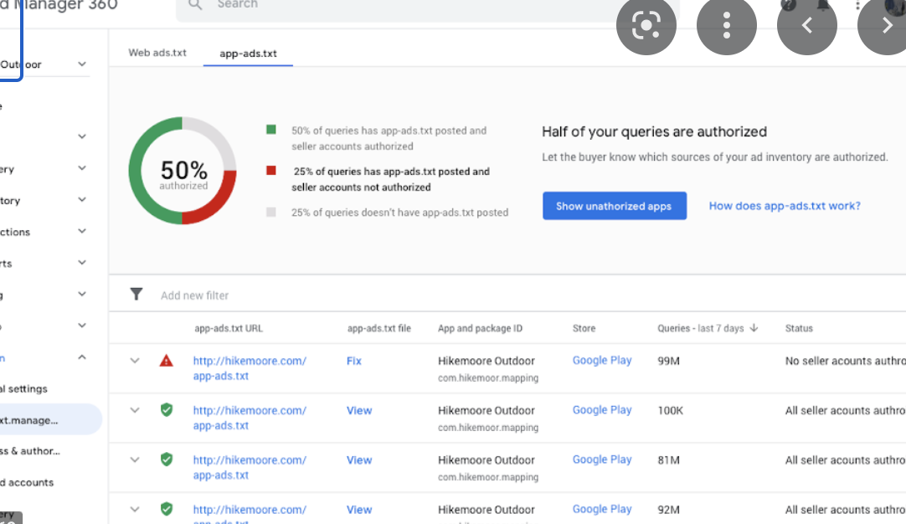



How to Identify?
BRAND COMMUNITY
Bliss club products inspire by 15K+ community
CHALLENGE CUSTOMER
Google Beta Model with Core Customers
FRICTION MAPPING
Dollar shave club upended Biz model to remove friction
Notes:
Useful Links
https://bretwaters.medium.com/case-study-dollar-shave-club-a9503fc83ea0

Slide 16
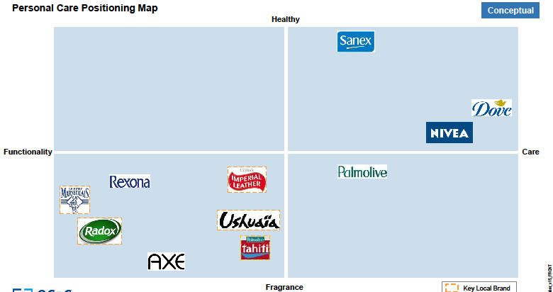
More – Mapping Exercises

Slide 17
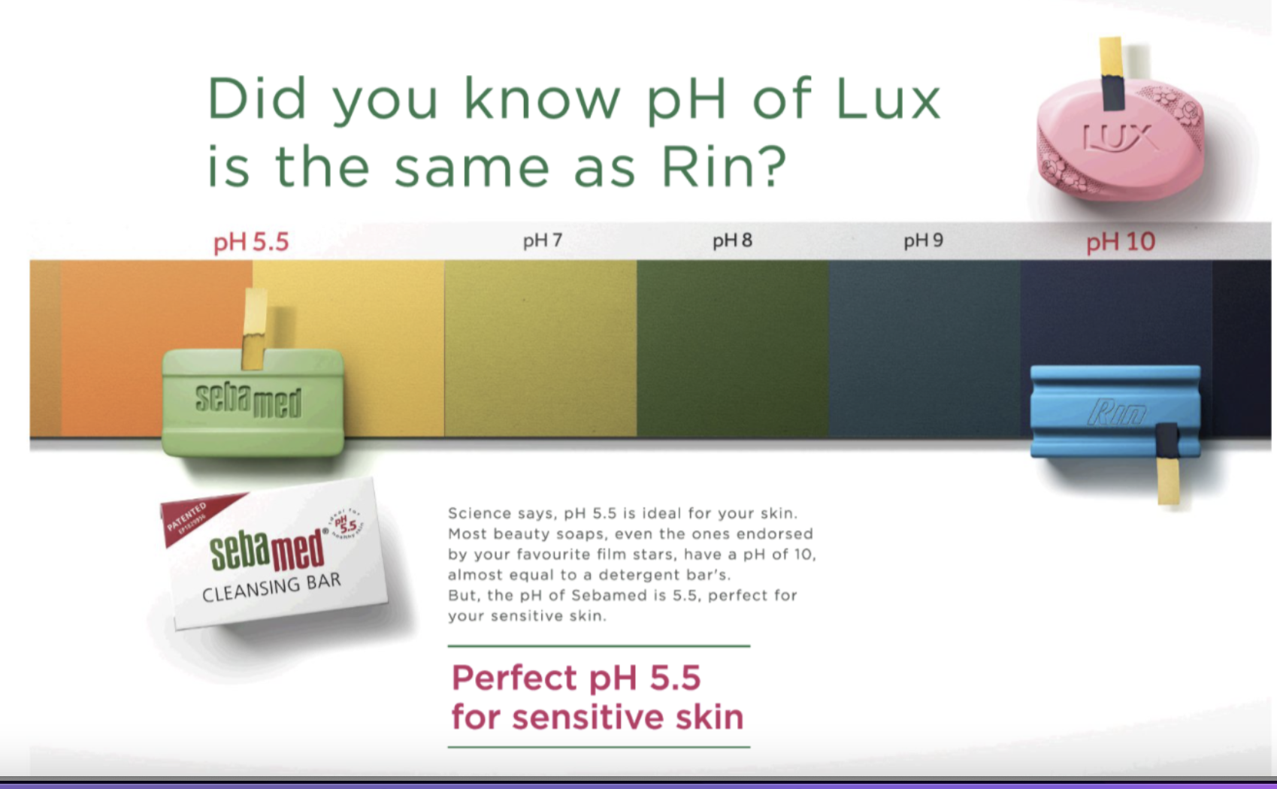
What is the pain point/opportunity that seba med was chasing

Slide 18

More – Mapping Exercises

Slide 19
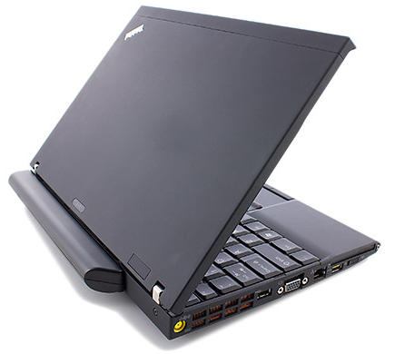

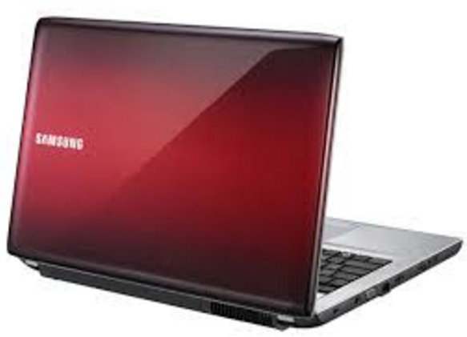
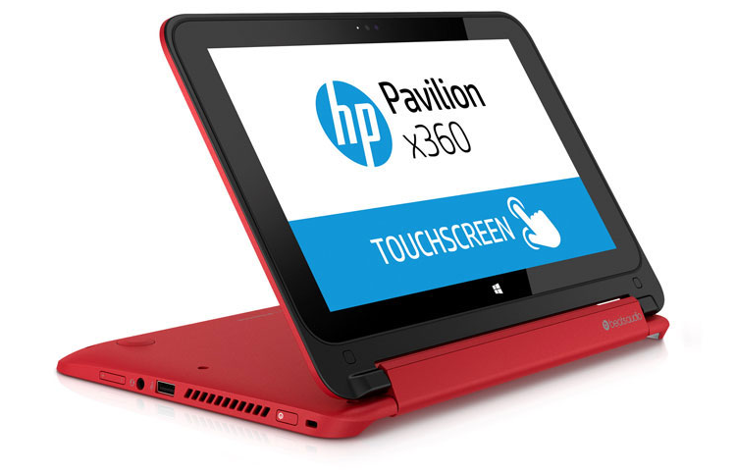
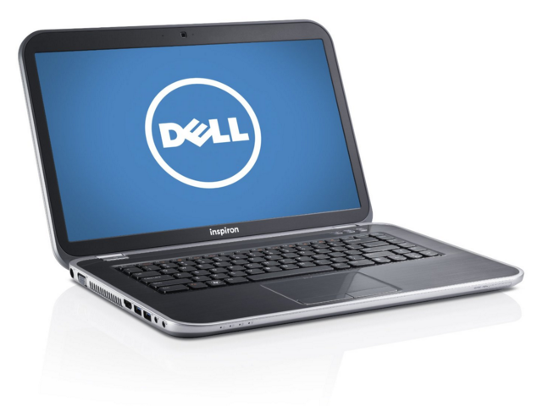
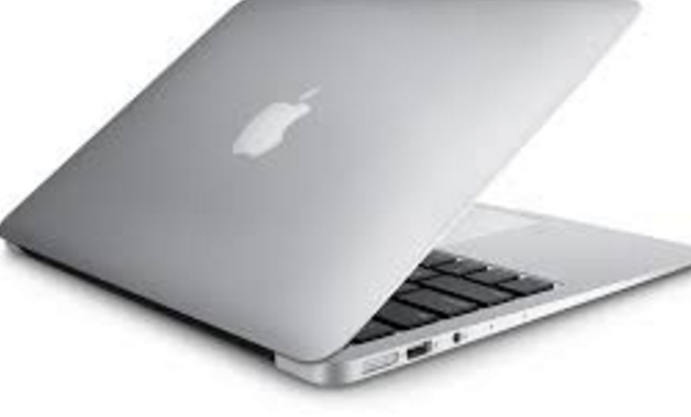
Let us try and get into Aaditya’s head….
Exercise - 7
Dude! This is for my Dad
Functionality
Style
So cool…

Slide 20
Mapping
Dude! This is for my Dad
Functionality
Style
So cool…

Slide 21

Give me one word that comes to mind when you think of Volvo

Slide 22
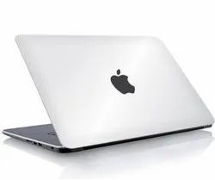
Give me one word that comes to mind when you think of Apple Laptops

Slide 23

Brand is whatever the customer thinks it is!

Slide 24


What is Positioning?
The act of designing
The company’s offering
So that it occupies
A distinct and valued place
In the target customers’ mind
Notes:
Positioning was first introduced by Jack Trout in 1969 ("Industrial Marketing" Magazine- June/1969) and then popularized by Al Ries and Jack Trout in their bestselling book "Positioning - The Battle for Your Mind." (McGraw-Hill 1981)
Thus, positioning, as the name implies, involves finding the proper “location” in the minds of a group of consumers or market segment so that they think about a ‘product’ or ‘service’ in the “right” or desired way.
Positioning is what you do to the mind of the consumer.

Slide 25
Positioning was first introduced by Jack Trout in 1969 ("Industrial Marketing" Magazine- June/1969) and then popularized by Al Ries and Jack Trout in their bestselling book "Positioning - The Battle for Your Mind." (McGraw-Hill 1981)
Thus, positioning, as the name implies, involves finding the proper “location” in the minds of a group of consumers or market segment so that they think about a ‘product’ or ‘service’ in the “right” or desired way.
Positioning is what you do to the mind of the consumer.

Slide 26

Positioning
Volvo
For upscale families, Volvo is the family automobile that offers maximum protection through obsessive innovation and R&D on safety
Apple
Apple computers offers the best personal computing experience to students, educators, creative professionals, through its innovative hardware, software and internet offerings

Slide 27
Clear Positioning Helps!
Link to Brand Essence!
Helps link to goals a consumer wants to achieve, in a unique and distinctive way

Slide 28

How to a craft a Positioning Statement
For upscale families, Volvo is the family automobile that offers maximum protection through obsessive innovation and R&D on safety
What all do you see in this statement?

Slide 29
Positioning Statement
Must have the following:
For upscale families, Volvo is the family automobile that offers maximum protection through obsessive innovation and R&D on safety
Target Segment
Frame of Reference
Point of
Differentiation
Reason to Believe

Slide 30
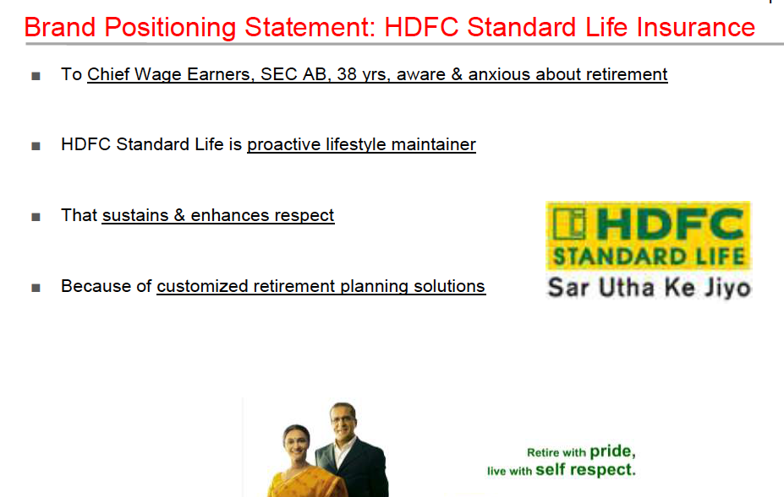
Brand Positioning Statement: HDFC Standard Life Insurance
To Chief Wage Earners, SEC AB, 38 yrs, aware & anxious about retirement
HDFC Standard Life is proactive lifestyle maintainer
That sustains & enhances respect
Because of customized retirement planning solutions
  Target Segment
  Frame of Reference
  Point of Difference
  Reason to Believe

Slide 31
Exercise – What is Missing?
Listerine Mouthwash
For Adults aged 30-40, Listerine gives you confidence of a healthier mouth as it has Superior Anti Germ Formula that has been clinically proven to be 34% more effective than brushing and flossing alone.

Slide 32
Exercise – What is Missing?
Listerine Mouthwash
For Adults aged 30-40, Listerine is germ-killing mouthwash that gives you confidence of a healthier mouth as it has Superior Anti Germ Formula that has been clinically proven to be 34% more effective than brushing and flossing alone.

Slide 33
Exercise – Which brand is this?
For Local and international travellers, ______is the only booking website that offers unique experiences worldwide because we offer the largest, most diverse, top rated personalised places to stay”

Slide 34
Exercise – Which part of the statement is missing
For Direct to consumer companies, Digipal is a SAS provider that seamlessly links all the operation under one platform

Slide 35
Exercise – Which part of the statement is missing
Maruti is a family car that delivers maximum
fuel efficiency through its advanced technology
and efficient car design

Slide 36
Positioning is Strategic
The Role of Positioning
POSITIONING
Strategic & Technological Vision
Product Development
Messaging
Provides Consumers Benefits
Tells the Story

Slide 37

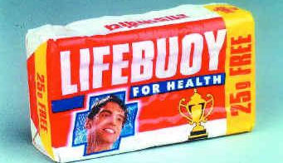
Case study - Lifebuoy
To the Indian Male, Lifebuoy is an Anti Germ Soap that will protect you from germs and keep you healthy because it has an antiseptic ingredient in carbolic acid
Notes:
“Lifebouy hain jahan tandurusti hain wahan”

Slide 38
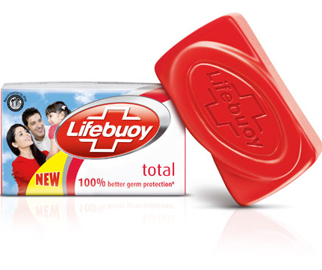
Changed the Positioning

Slide 39

What Was the New Positioning?
To the discerning housewife who cares about the health of the family, Lifebuoy is an anti germ soap that has Active B formula that will provide maximum protection for you and your family

Slide 40
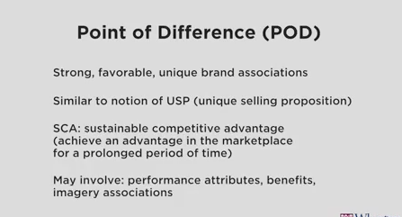
Point of differentiation (POD)
Strong, favourable, unique brand associations
Similar to notion of USP (unique selling proposition)
SCA: sustainable competitive advantage (achieve an advantage in the marketing for a prolonged period of time)
May involve: performance attributes, benefits, imagery associations

Slide 41
Point of Parity (POP)
Associations that are not unique to the brand: they are shared with brands
Category POPs: Associations consumer views as necessary to be considered credible
  Ex: Grocery store must have certain products (e.g.., milk, eggs to be truly considered a grocery store.
Competitive POPs: Associations designed to negate competitors point of difference
  All toothpastes prevent cavities

